Slide 1
Part II: Rocky Mountain Climate Analysis Slides

Slide 2
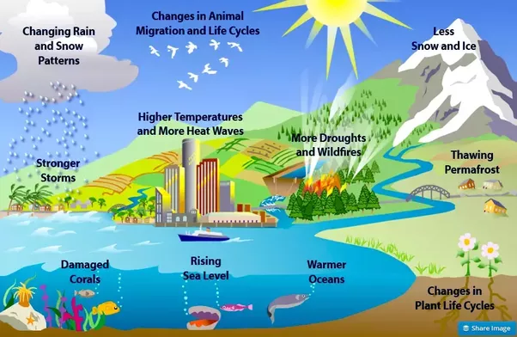
How are species or ecosystems affected by climate change?
Image credit: US EPA

Slide 3
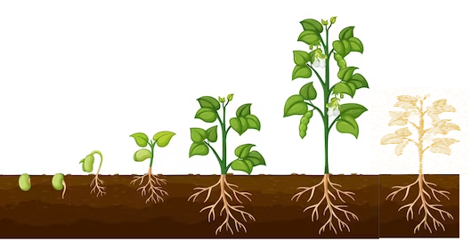
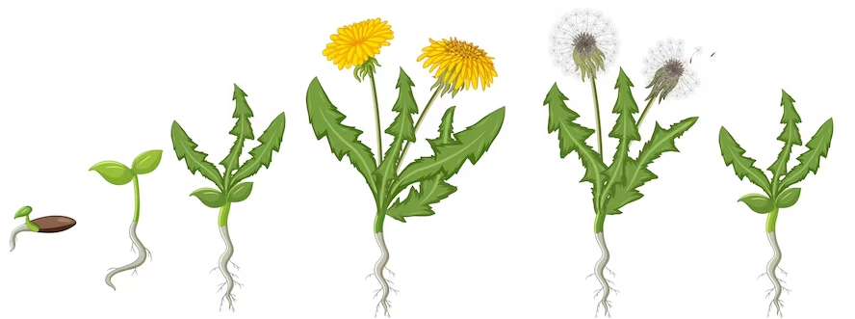
Phenology – the timing of events in an organism’s life cycle; important events are timed to match resources (food, water, etc.)
Plants grow and flower when it is:
Warmer
Sunnier
Wetter
Pollinators are around
Plants can adapt their phenology to their local environment- events may be earlier or later in the year depending on the geographic location
Annual plant
Germination – Growth – Reproduction - Death
Spring Summer Fall Winter
Perennial plant
Germination - Growth - Reproduction - Dormancy
Spring Summer Fall Winter
Image credits: brgfx on Freepik

Slide 4
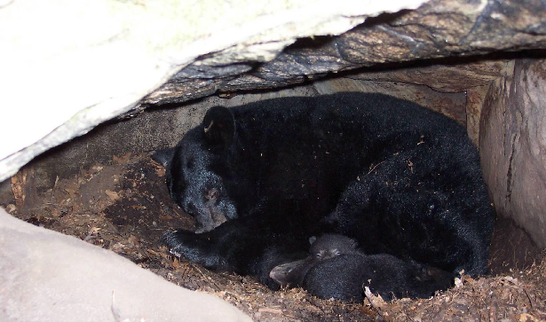
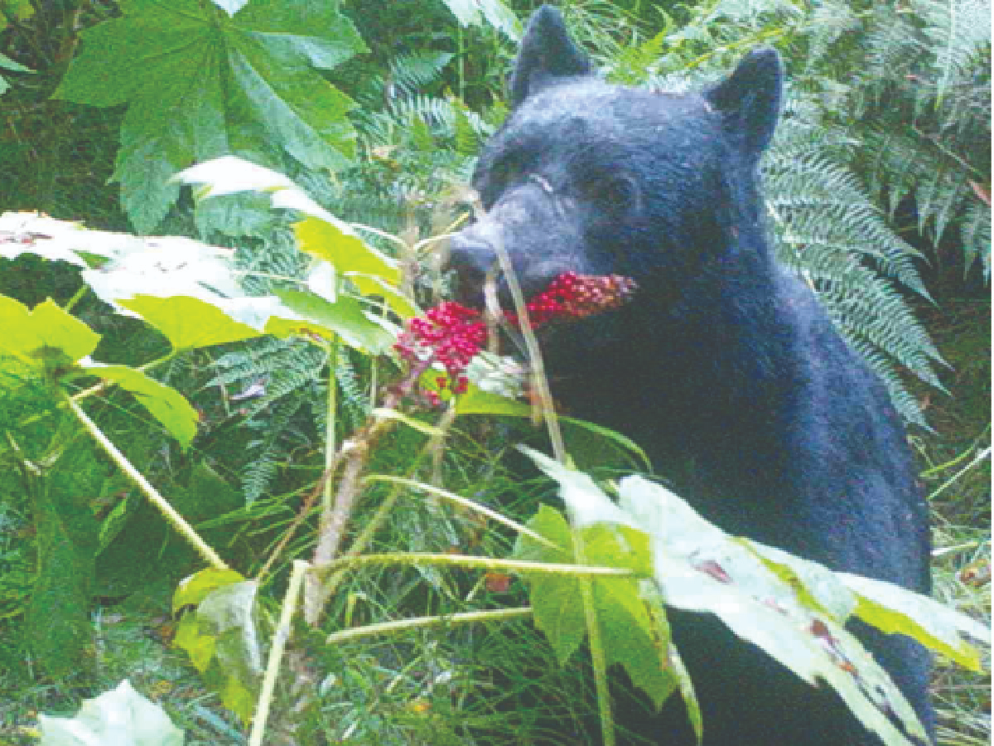
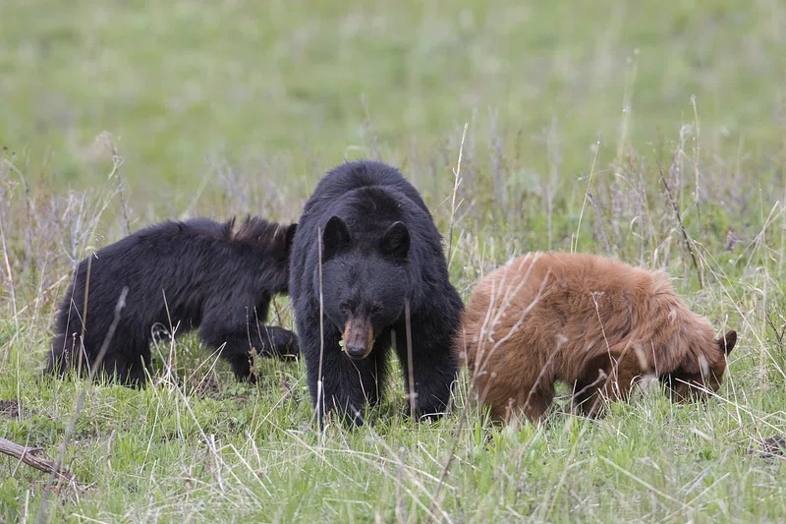
Phenology – the timing of events in an organism’s life cycle; important events are timed to match resources (food, water, etc.)
Bears:
Hibernate and reproduce when no food is around (plants dormant)
Grow and feed when plenty of food water
Fatten up on seeds/fruits at end of season to prep for winter
Winter
Fall
Spring
Summer
Animals also adapt their phenology to their local environment
Image credits: nps.gov and Taal Levi, Oregon State University

Slide 5
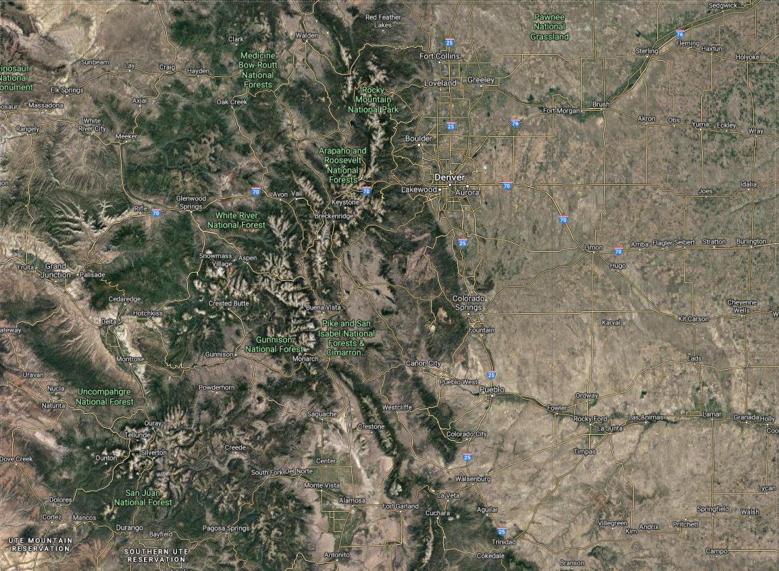
Guiding question: How is plant phenology affected by climate change?
Research site: Rocky Mountain Biological Lab (Gothic, CO)
~9,500 ft. elevation

Slide 6
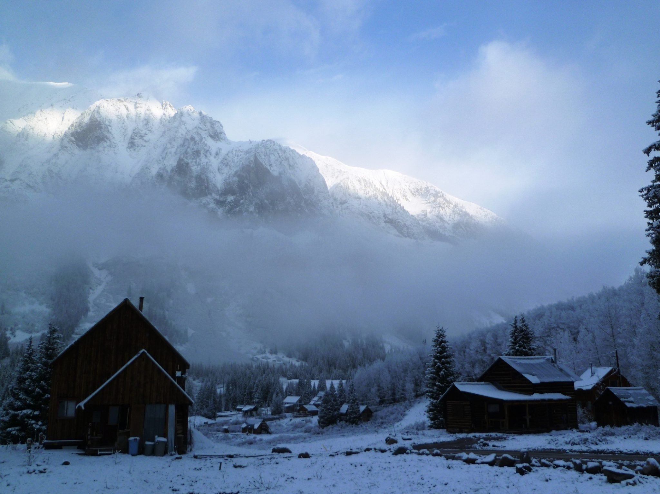
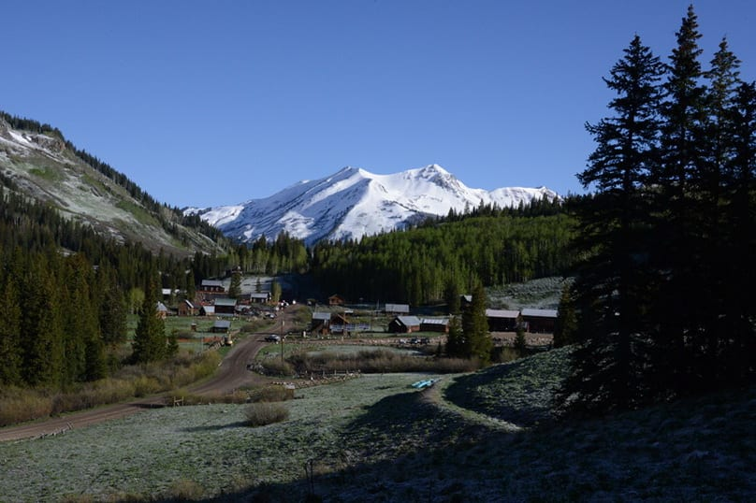
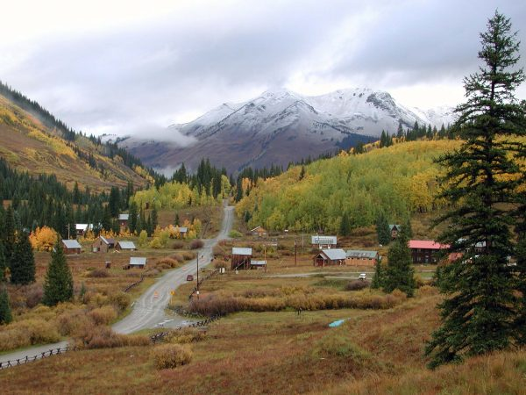
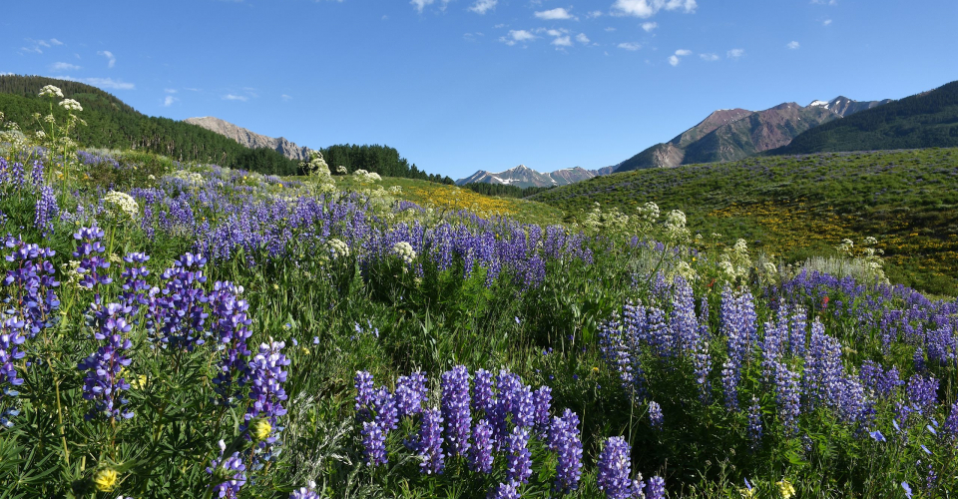
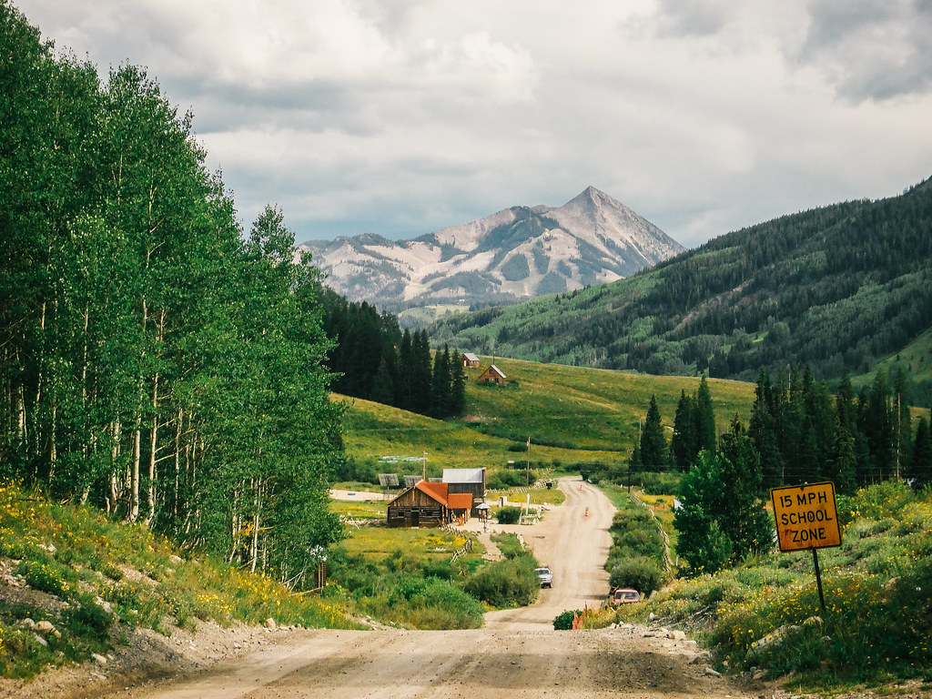
A year in Gothic, Colorado
Winter (Jan - April)
Spring (April - May)
Fall (Sept - Oct)
Winter (Nov - Dec)
Summer (June – August)
Image credits: RMBL, Viv Lynch, (flickr), David Inouye

Slide 7
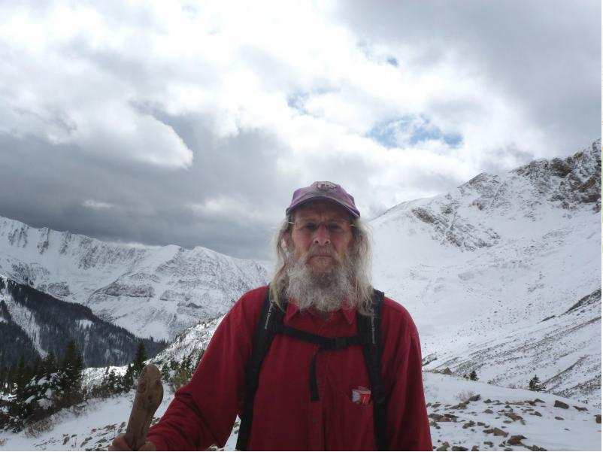
Plant phenology project part I – RMBL Climate analysis
Download or access the dataset through our Canvas site/Google sheets
Use the data to answer the following questions on the worksheet
Q1: According to the winter data, has the climate changed over 45 years at this location? If so, how?
Q2: According to the spring data (May), has the climate changed over 45 years at this location? If so, how?
billy barr- has been measuring weather data daily for 45 years
Image credit: RMBL

Slide 8
Part III: Plant Phenology Analysis Slides

Slide 9
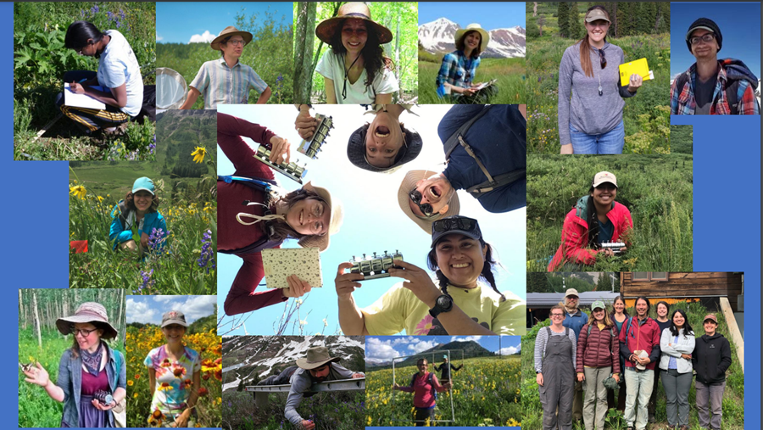
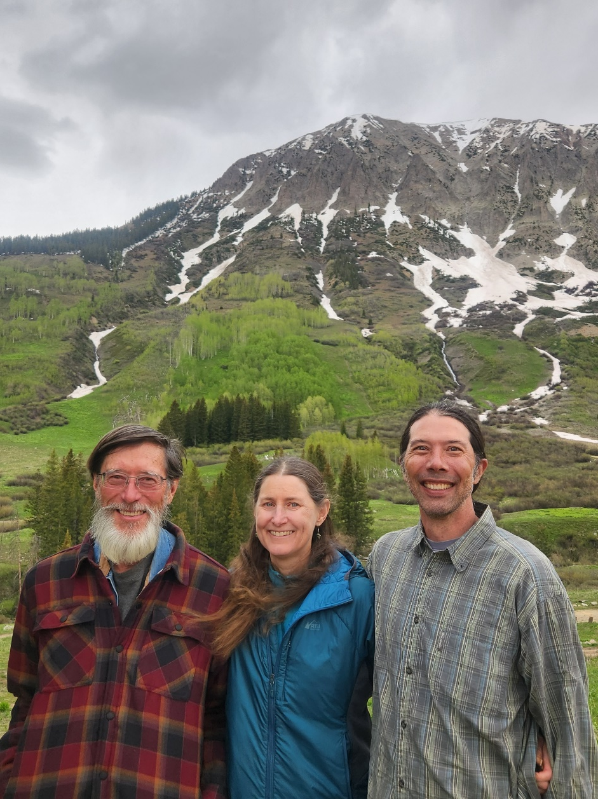
Drs. David Inouye, Nora Underwood, and Brian Inouye (and their research team) have been measuring the flowers at RMBL every year for over 45 years.
photo by M. Inouye

Slide 10
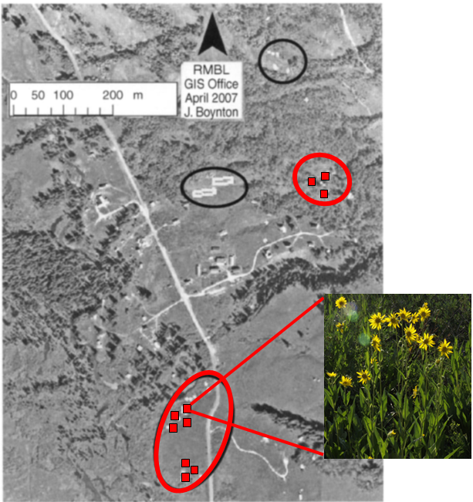
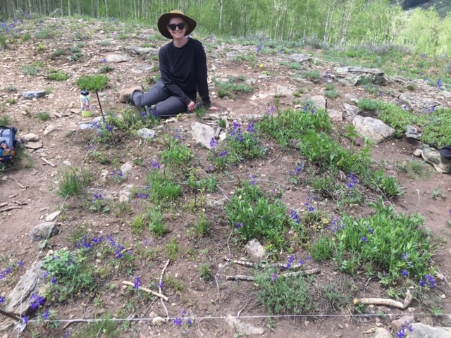
Study setup:
23 2m x 2m plots in the fields around the lab
Three times a week in the summer, total number of open flowers of each species counted in each plot by researchers
modified from Inouye (2008)

Slide 11
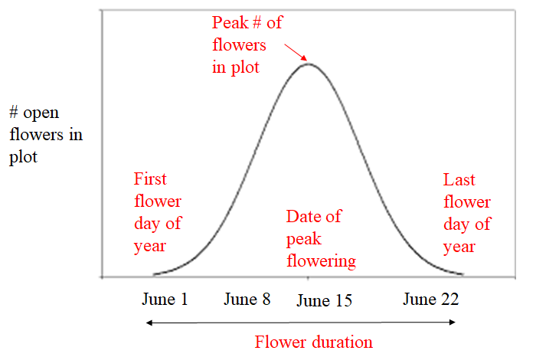
Variables you will be analyzing:

